Slide 1
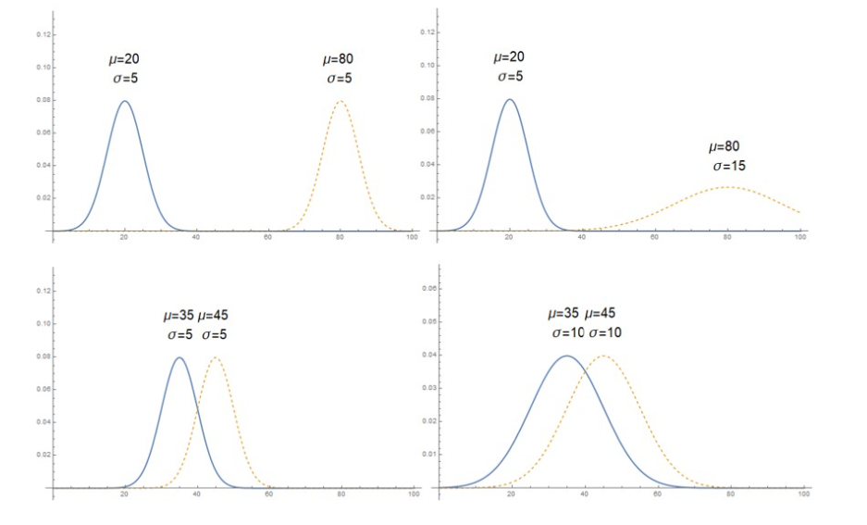
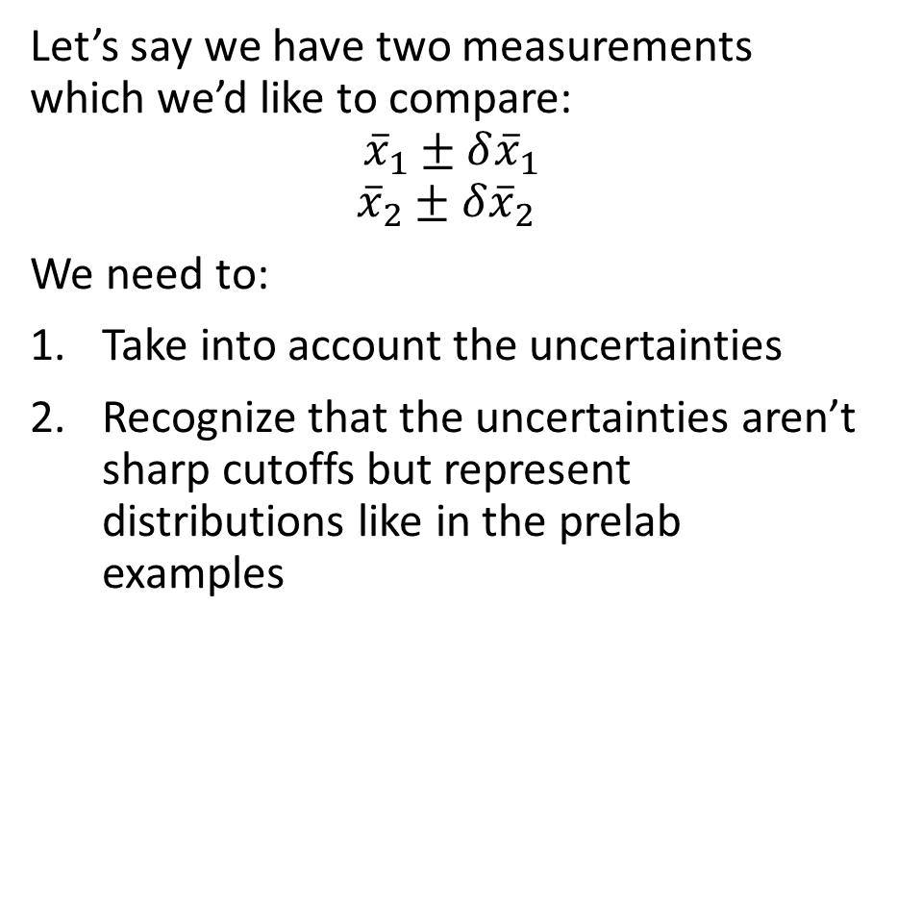
[Lab 1] Comparing Measurements
Let’s say we have two measurements which we’d like to compare:
$${\overline{x}}_{1}±δ{\overline{x}}_{1}$$
$${\overline{x}}_{2}±δ{\overline{x}}_{2}$$
We need to:
Take into account the uncertainties
Recognize that the uncertainties aren’t sharp cutoffs but represent distributions like in the prelab examples

Slide 2
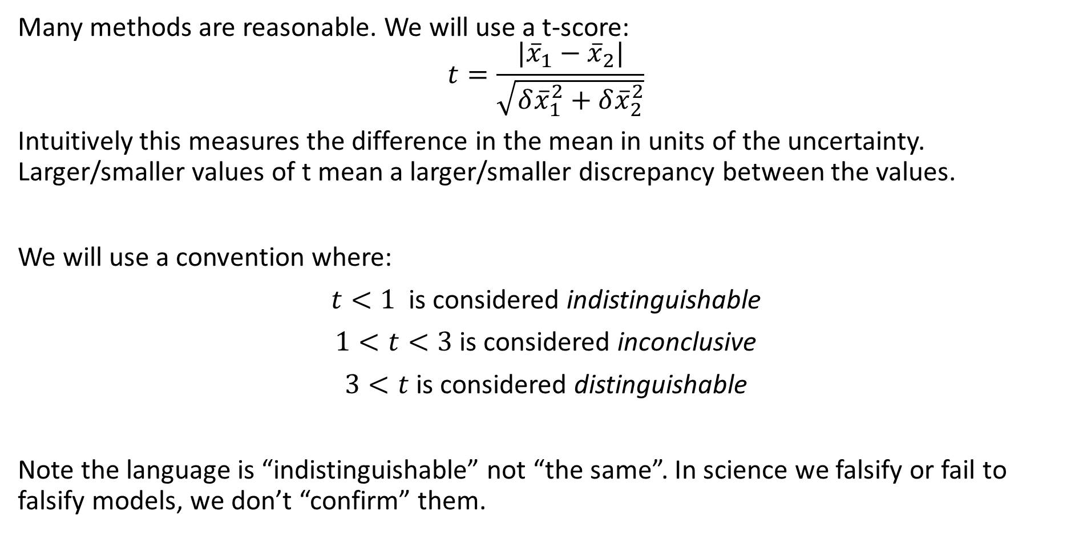
[Lab 1] Comparing Measurements
Many methods are reasonable. We will use a t-score:
$$t=\frac{|{\overline{x}}_{1}−{\overline{x}}_{2}|}{\sqrt{δ{\overline{x}}_{1}^{2}+δ{\overline{x}}_{2}^{2}}}$$
Intuitively this measures the difference in the mean in units of the uncertainty. Larger/smaller values of t mean a larger/smaller discrepancy between the values.
We will use a convention where:
$t<1$ is considered indistinguishable
$1<t<3$ is considered inconclusive
$3<t$ is considered distinguishable
Note the language is “indistinguishable” not “the same”. In science we falsify or fail to falsify models, we don’t “confirm” them.

Slide 3
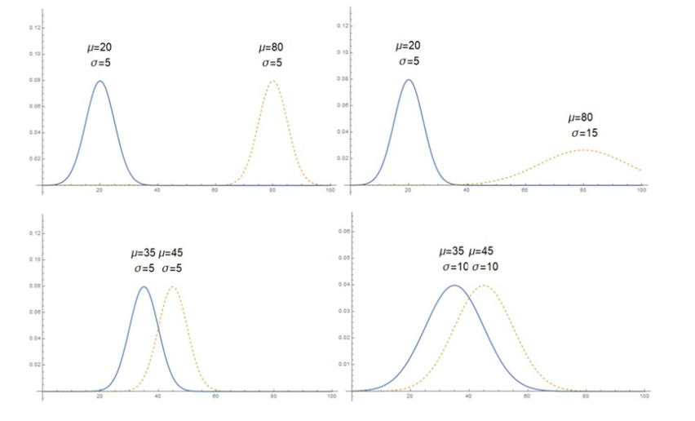








[Lab 1] Comparing Measurements
We can apply this to the prelab examples to connect intuition with the mathematical expression:
$$t=\frac{|20−80|}{\sqrt{5^{2}+5^{2}}}≈8.5$$
$$t=\frac{|20−80|}{\sqrt{5^{2}+{15}^{2}}}≈3.8$$
$$Distinguishable$$
$$Distinguishable$$
$$t=\frac{|35−45|}{\sqrt{5^{2}+5^{2}}}≈1.4$$
$$t=\frac{|35−45|}{\sqrt{{10}^{2}+{10}^{2}}}≈0.7$$
$$Inconclusive$$
$$Indistinguishable$$

